Slide 1
Business Applications
Dynamics 365 and Power Platform: Extending the Power Platform

Slide 2

Agenda
Dynamics 365 and Power Platform: Extending the Power Platform
Whiteboard Design Session: Designing a collaborative Microsoft 365 environment that includes power platform and D365 integrations. We will be collaborating with the Modern Workplace group for this one!
Team Challenge: Delivering a collaborative Microsoft 365 environment that includes power platform and D365 integrations.

Slide 3
Daily Rundown
Timeframe | Activity | Engagement
8:00 – 9:00 | Extending the Power Platform | Interactive Discussion
9:00 – 11:00 | Whiteboard Design Session
11:00 – 12:00 | Long Break
12:00 – 2:00 | Team Challenge | Hands On: Group Work
2:00 – 2:15 | Wrap Up (Office Hours)

Slide 4
Extended Platform
Notes:
The power platform is much like the universe: it is forever expanding. Just when you think you’ve found the limit, it will grow.
One of the greatest strengths of the Power Platform (and by now you’re used to me saying this phrase… there are a lot of great strengths), is that it’s able to continue growing – and as Microsoft continues to invest in it things will only get better!
Today we’re going to touch on some of the “Additional” features of the Power Platform. Some, like Power Automate, are officially part of the Power Platform. Others, like Power Virtual Agents and Teams, provide users with additional tools and features to support their business processes.

Slide 5
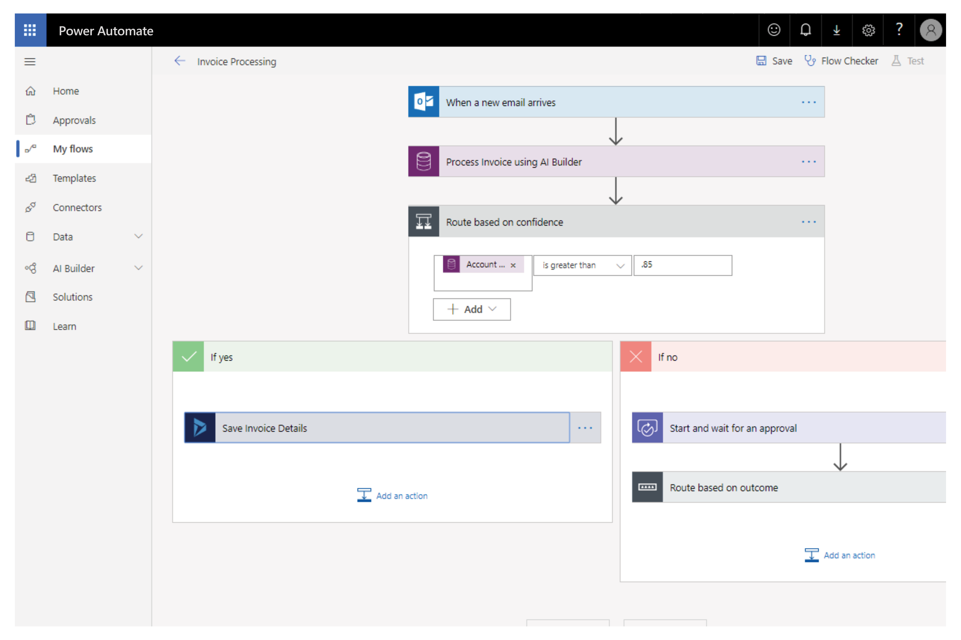
Automate and integrate business processes with Power Automate
Automate and model business processes across your apps and services
From simple automations to advanced scenarios with branches, loops, and more
Trigger actions, grant approvals, and get notifications right where you work
Automate legacy, on-prem and cloud-based applications and services
Notes:
Who remembers what Power Automate was called just a year ago? Flow.
Now we create a Flow inside of Power Automate.
Flow is built on the idea of triggers and actions, with hundreds of connectors (Including the CDS, Sharepoint, and even non-Microsoft products).
Have a customer inquiry posted to a Teams channel
Create an approval process
Use a flow button to turn on your home sprinkler system!
If you’re curious to learn more, check out the blog links for Ed Gonzales or David Yack. Both MVP’s with infectious loves of Power Automate.

Slide 6
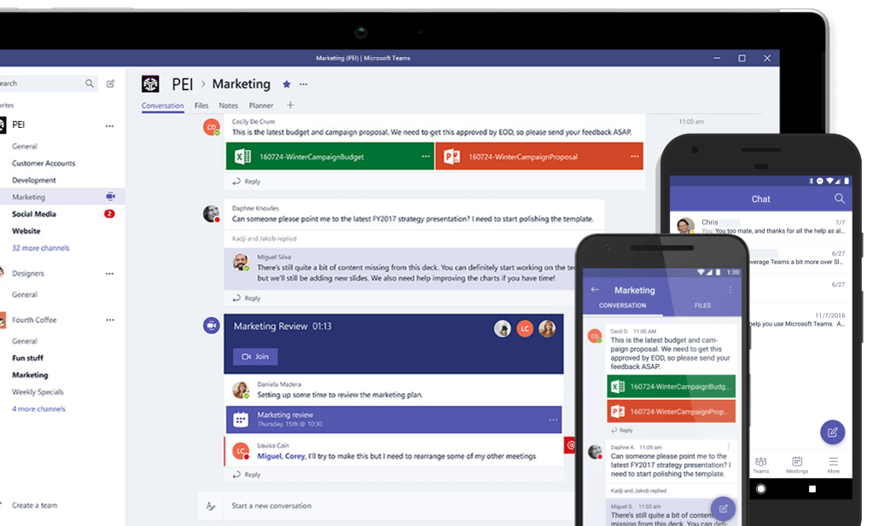
Teams
Display Powerapps (including Dynamics apps) and interact with data within Teams
Use Bots to communicate
With project oakdale, create powerapps and bots from within Teams
Notes:
There are many ways to expand the Power Platform using teams.
You can display a canvas app in teams, for users to interact with.
Add a Dynamics tab to display a window into a dynamics app right inside a teams channel (where users can use the Dyamics app as if they were in a separate browser!)
Use the Dynamics Bot to search for “Open Leads” for contacts and link them to their open leads in Dynamics.
With the addition of Project Oakdale (which is sometimes unofficially referred to as “CDS Lit”), you can create Apps right from within Teams. Project Oakdale delivers a built-in, low-code data platform for Teams and enables everyone to easily build and deploy apps and intelligent chatbots in Teams with Microsoft Power Apps and Microsoft Power Virtual Agents. This fully integrated Power App authoring experience optimized for Microsoft Teams allows creators to build, deploy, share, use and administer Power Apps solutions from within Teams.
A few things to consider– Project Oakdale will create a new environment. So when you create an app, you are not connecting to your current CDS database. And connecting that data is not simple or easy (or seamless). However, keep in mind that Project Oakdale is very new and will likely include changes and updates in the coming years – so keep an eye out for these!
If you need to connect with CDS, there are many ways to connect your CDS database, and even Canvas Apps, to your teams environment.

Slide 7

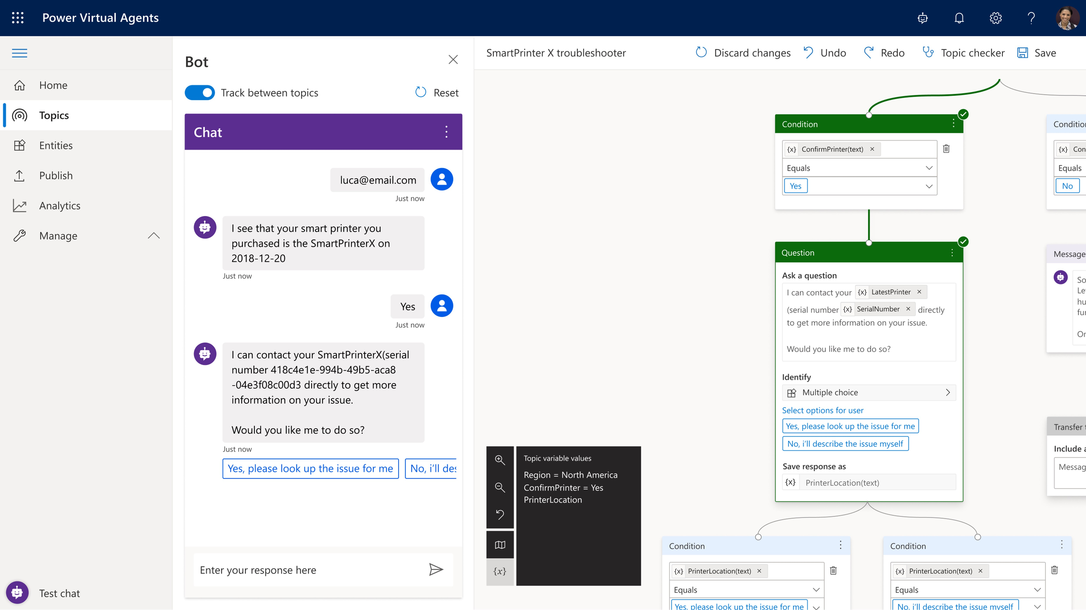
Build powerful virtual agents with Power Virtual Agents
Enable subject matter experts to easily create powerful virtual agents using a guided, no-code graphical interface—all without the need for data scientists or developers
Enable the virtual agent to take action on the customer’s behalf; Easily integrate your virtual agent with hundreds of services and systems out of the box or create custom workflows
Keep an eye on how your virtual agent is performing by using conversational metrics and dashboards; Get in-depth AI-driven insights to improve bot performance

Slide 8
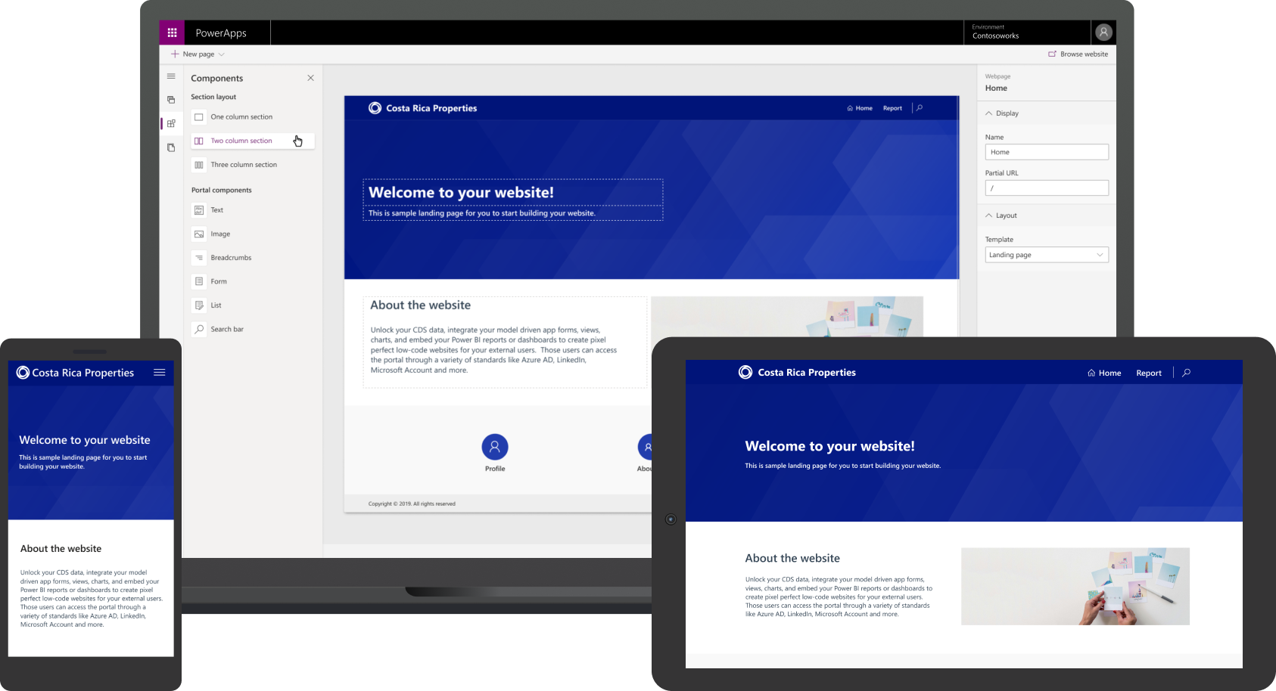
Allow clients to interact with CDS data securely with Power Apps Portals
Engage with external customers and partners
Enable anyone to build responsive websites
Integrate all of your data
Notes:
Give internal and external users secure access to your data either anonymously or through commercial authentication providers like LinkedIn, Microsoft, Facebook, and Google, or enterprise providers such as Azure AD B2C and Okta. Set authentication requirements, customize data for each user, and allow users to submit their information privately with straightforward admin controls.
Easily match websites to the look and feel of your branding with customizable portal templates and responsive themes. Create and manage the content external users and partners can access using an intuitive interface and step-by-step guidance—no code required.

Slide 9
Demo
Teams (Project Oakdale)
Power Virtual Agent
Power Automate
Power BI
Portals
Notes:
Teams (Project Oakdale)
Power Virtual Agent
Power Automate
Power BI
Portals

Slide 10
Discussion Point
How do you think DevOps changes the dynamic of IT Leaders?
Can you articulate the Azure/Microsoft DevOps story?

Slide 11

Whiteboard Design Session
Design a collaborative Microsoft 365 environment that includes Power Platform and Dynamics 365 integrations.

Slide 12
Long Break
Please return to the session by 12:00pm PT

Slide 13
Team Challenge
Delivering a collaborative Microsoft 365 environment that includes power platform and D365 integrations.

Slide 14
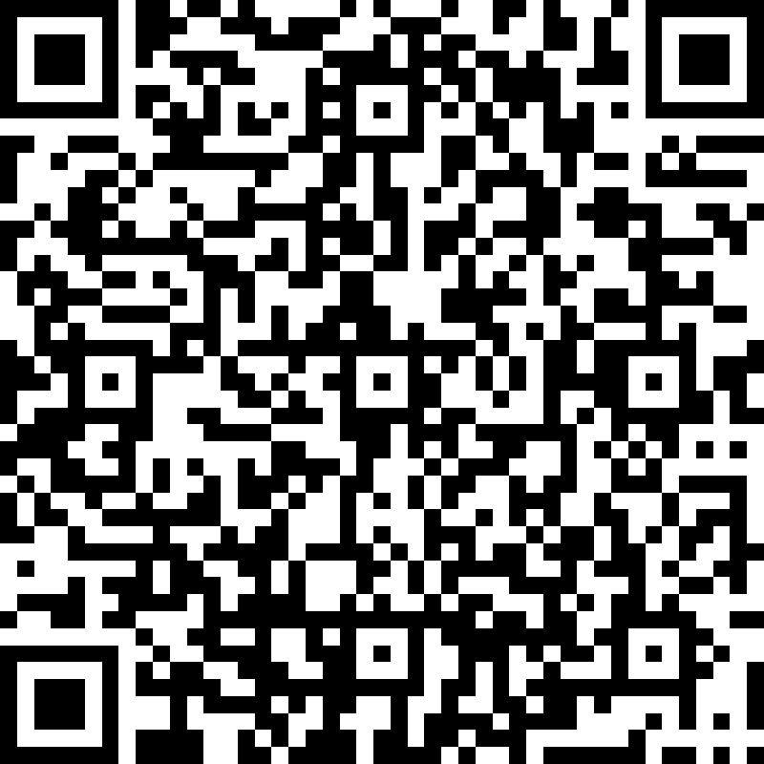
Survey
https://aka.ms/CloudCoresurvey

Slide 15
Office Hours

